Slide 1


Bauhaus Universität Weimar Faculty of Media Degree Programme: M.Sc. Digital Engineering
COHERENCE BASED TEXT QUALITY
IN SEARCH-SUPPORTED WRITING
MASTER’S THESIS DEFENCE
1 Referee: Prof. Dr. Benno Stein 2 Referee: Prof. Dr. Ing. Volker Rodehorst
Supervised By:
Dr. Michael Völske Dr. Magdalena Wolska
Presenter: Date: 14.01.2022
Bibek khadayat
Bauhaus University, Weimar

Slide 2
Motivation
1
Numbers of texts, essays, journals, articles, books are written.
2
Every one would like to assess their written text .
3
Numbers of measures for judgement of text quality
4
Coherence is one of the most important factor to be checked in text.
Bauhaus University, Weimar
2
Notes:
Numbers of text are written everyday
There are many measures which are used for the judgement of the text
Every one would like to assess the quality of the text they have written before sharing or publishing it.
One important thing what I think is that every one would like to check that the text they have written is bounded within same topic or not.

Slide 3







INTRODUCTION
CONCLUSION
Areas of Impact
Search-Supported writing
Research Questions
Conclusions
Future Work
OUTLINE
DATA AND DATASETS
RESULTS AND ANALYSIS
Data Acquisition Setup
Data Collected
Prior Analysis
Different Editing Type
Effects of Editing Type
Effects of Writing Styles.
DATA PREPROCESSING
Data Extraction
Data Cleaning
Identification of Major Changes
Data Analysis
EDITING TYPES
Examples of Editing Types.
Automated Detection of Editing Type
TEXT QUALITY MEASURES
Methodology for Coherence
Methodology for Type-Token Ratio
Methodology for Readability
Bauhaus University, Weimar

Slide 4







INTRODUCTION
AREAS OF IMPACT
TEXT QUALITY
SEARCH-SUPPORTED
WRITING
RESEARCH QUESTIONS
Bauhaus University, Weimar

Slide 5
INTRODUCTION
TEXT QUALITY
FACTORS THAT DEFINE TEXT QUALITY
Spelling.
Vocabulary.
Grammar.
Structure.
Organization.
Readability, and so on.
Bauhaus University, Weimar
Notes:
Before talking about text quality lets think what is a text.
In simple word text is the combination of word , sentences in a meaningful way
Also in linguistics text refer to any passage that is spoken, or written, of whatever length, that is in a unified form.
Talking about the text quality. A text which is well organized, easily understandable, audience can go through the text easily from the starting to end can be called high quality text.
Text quality may depend on the language skills of the audiences.

Slide 6
INTRODUCTION
TEXT QUALITY
Logical or conceptual connection of the text .
COHERENCE
Lexical connection of text.
COHESION
ease with which audience read and understand the text
READABILITY
Bauhaus University, Weimar
Notes:
evaluate whether the sentence are logically and conceptually consistent throughout a text. Whether text are bounded with in same idea or not.
whether a sentences in the text are linked together on the basis of grammar and lexical

Slide 7
INTRODUCTION
TEXT QUALITY
Coherent text | Cohesive Text
Nepal is a small and beautiful country. Many tourists visit Nepal because of its beauty and nature. White mountains, green forests, wildlife reserves etc., lure people from different countries. | Nepal is a small country. Nepal is located in between India and China. Its area is 147516 sq. kilometers.
Bauhaus University, Weimar

Slide 8
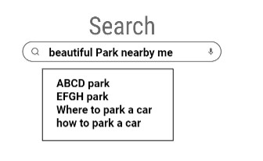
INTRODUCTION
AREAS OF IMPACT
Web search recommendation
Bauhaus University, Weimar

Slide 9
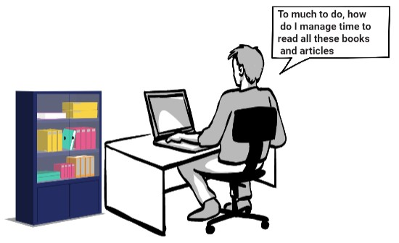
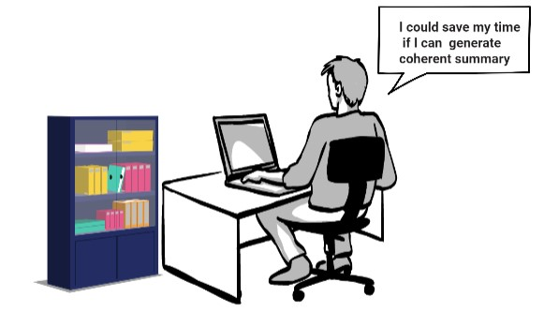
INTRODUCTION
AREAS OF IMPACT
Automatic Summarization
Bauhaus University, Weimar

Slide 10
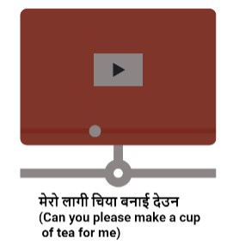
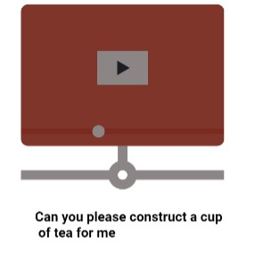
INTRODUCTION
AREAS OF IMPACT
Machine Translation
Bauhaus University, Weimar

Slide 11

INTRODUCTION
AREAS OF IMPACT
Writing Assessment
Bauhaus University, Weimar

Slide 12
INTRODUCTION
SEARCH-SUPPORTED WRITING
01
Use of Internet for research purpose and gather information.
02
Use this information in writing.
Bauhaus University, Weimar
Notes:
Gather information and data with the help of search engine.

Slide 13
INTRODUCTION
RESEARCH QUESTIONS
RQ1
What are the different types of editing techniques in search-supported writing ?
RQ2
How do different types of editing affect Coherence, Type-Token ratio, and Readability?
RQ3
How do different essay writing strategies affect Coherence, Type-Token ratio, and Readability?
Bauhaus University, Weimar

Slide 14

DATA AND DATASETS
DESCRIPTION OF DATASETS
DATA ACQUISITION SETUP
PRIOR ANALYSIS
COLLECTED DATA
Bauhaus University, Weimar

Slide 15





DATA AND DATASETS
DESCRIPTION OF DATASETS
M. Potthast, M. Hagen, M. Völske, J. Gomoll, and B. Stein, Webis text reuse corpus 2012, Zenodo, Sep. 2012. doi: 10.5281/zenodo.1341602. [Online]. Available: https://doi.org/10.5281/zenodo.1341602
Text Reuse Corpus 2012 (Webis-TRC-12)
150 long essays written by professional writers.
Information from ClueWeb09 corpus.
Detailed interaction logs and revision history.
Available on webis website
Bauhaus University, Weimar
Notes:
150 long essays written by the professional writer hired at the crowd sourcing platform oDesk
Information are used from ClueWeb09 corpus with the help of search supported writing technique
Contain detailed interaction logs file that covers the construction of corpus as well as the history of the search for source.

Slide 16

DATA AND DATASETS
DESCRIPTION OF DATASETS
M. Potthast, M. Hagen, M. Völske, J. Gomoll, and B. Stein, Webis text reuse corpus 2012, Zenodo, Sep. 2012. doi: 10.5281/zenodo.1341602. [Online]. Available: https://doi.org/10.5281/zenodo.1341602
Bauhaus University, Weimar
Notes:
150 long essays written by the professional writer hired at the crowd sourcing platform oDesk
Information are used from ClueWeb09 corpus with the help of search supported writing technique
Contain detailed interaction logs file that covers the construction of corpus as well as the history of the search for source.

Slide 17



DATA AND DATASETS
DATA ACQUISITION SETUP
M. Potthast, M. Hagen, M. Völske, and B. Stein, “CrowdsourcingInteraction Logs to Understand Text Reuse from the Web,” in 51stAnnual Meeting of the Association for Computational Linguistics (ACL2013), P. Fung and M. Poesio, Eds., Association for Computational Linguistics, Aug. 2013, pp. 1212–1221. [Online]. Available: http://www.aclweb.org/anthology/P13-1119.
Editor, Search Engine, and Datasets were provided to writer.
Dataset used: a set of topics, and a set of web pages to search.
ChatNoir is used as search engine
Bauhaus University, Weimar
Notes:
Two datasets are used to create this dataset: a set of topic, and a set of web pages to.
The Webis-TRC-12 writers were instructed to reuse (and, optionally, modify) text from web sources for their essays
When reusing text, humans may follow a three-step : searching for appropriate sources on a given topic, copying of text from selected sources, modification and paraphrasing of the copied text
ChatNoir is used as search engine that employ BM25F as the retrieval model in ClueWeb09

Slide 18



DATA AND DATASETS
COLLECTED DATA
M. Potthast, M. Hagen, M. Völske, and B. Stein, “CrowdsourcingInteraction Logs to Understand Text Reuse from the Web,” in 51stAnnual Meeting of the Association for Computational Linguistics (ACL2013), P. Fung and M. Poesio, Eds., Association for Computational Linguistics, Aug. 2013, pp. 1212–1221. [Online]. Available: http://www.aclweb.org/anthology/P13-1119.
Different revisions created in each essays or topics.
Final revisions of most of the essays are around 5000 words.
Essays: 150
Writer: 12
Revision/Essay: 2827
Words/Final revision: 5040
Bauhaus University, Weimar
Notes:
Research on topic and writing effort about topic were done simultaneously.
Two datasets are used to create this dataset: a set of topic, and a set of web pages to.
Writer or Author create different revisions during writing process in each essays or topics.

Slide 19
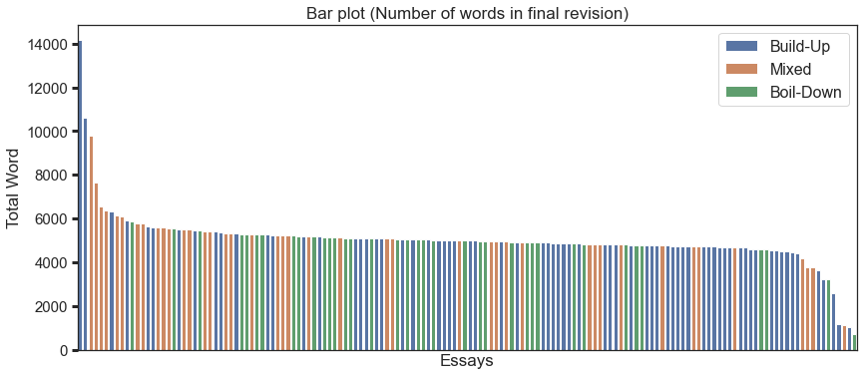
DATA AND DATASETS
COLLECTED DATA
Bauhaus University, Weimar

Slide 20




DATA AND DATASETS
LEGEND
Research and copy paste
PRIOR ANALYSIS
Edit
M. Potthast, M. Hagen, M. Völske, and B. Stein, “CrowdsourcingInteraction Logs to Understand Text Reuse from the Web,” in 51stAnnual Meeting of the Association for Computational Linguistics (ACL2013), P. Fung and M. Poesio, Eds., Association for Computational Linguistics, Aug. 2013, pp. 1212–1221. [Online]. Available: http://www.aclweb.org/anthology/P13-1119.
Writing Style
Build-up: continuous lengthening of the essay over the whole writing.
Boil-down: quick early length growth and then shorting
Mixed writing style have both Build-Up and Boil-down aspects.
Bauhaus University, Weimar
Notes:
Build-up: is a fashion, in which continuous lengthening of the essay in a regular period of time over the whole period of writing is done.
Boil-down is a fashion, in which first quick length growth and then shorting happen.
Mixed writing style have included both Build-Up and Boil-down.

Slide 21
DATA PREPROCESSING
DATA EXTRACTION
DATA CLEANING
DATA ANALYSIS
IDENTIFICATION OF
MAJOR CHANGES
Bauhaus University, Weimar

Slide 22





DATA PREPROCESSING
DATA EXTRACTION AND DATA CLEANING
STEP 4
Data Cleaning
STEP 3
Use html2text library
STEP 2
Parse raw HTML using Beautiful soup
STEP 1
Open HTML file
Bauhaus University, Weimar

Slide 23
DATA PREPROCESSING
IDENTIFICATION OF MAJOR CHANGES
01
Too much of data to visualize
02
Check coherence score across adjacent revision
03
Select only major changes
Bauhaus University, Weimar
Notes:
Not feasible to visualize text quality measures changes across every revision of each of the 150 essays.
Checked the coherence scores of every pair of adjacent revisions across paragraphs.
If they are the same, skip the result of the second revision and compared its results with the following revision.

Slide 24
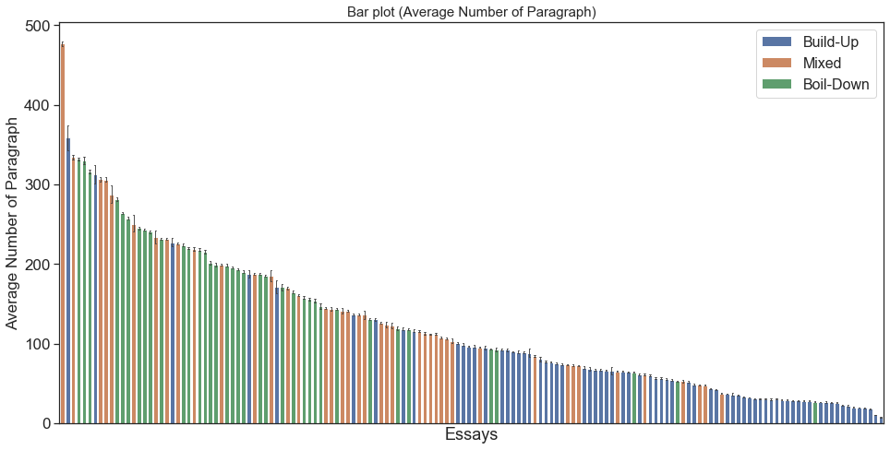
DATA PREPROCESSING
DATA ANALYSIS
Average number of paragraphs.
Bauhaus University, Weimar

Slide 25
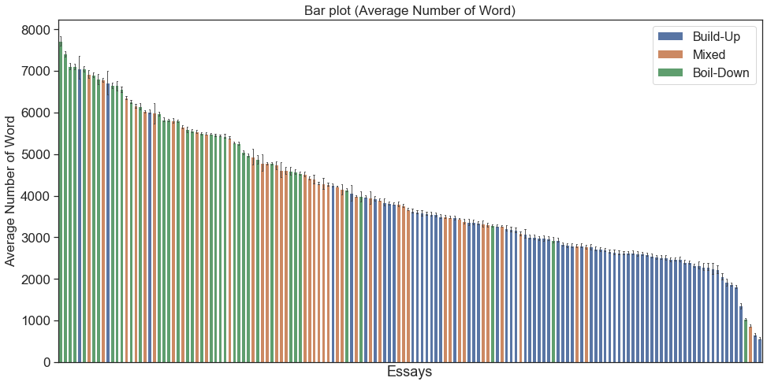
DATA PREPROCESSING
DATA ANALYSIS
Average number of words.
Bauhaus University, Weimar

Slide 26
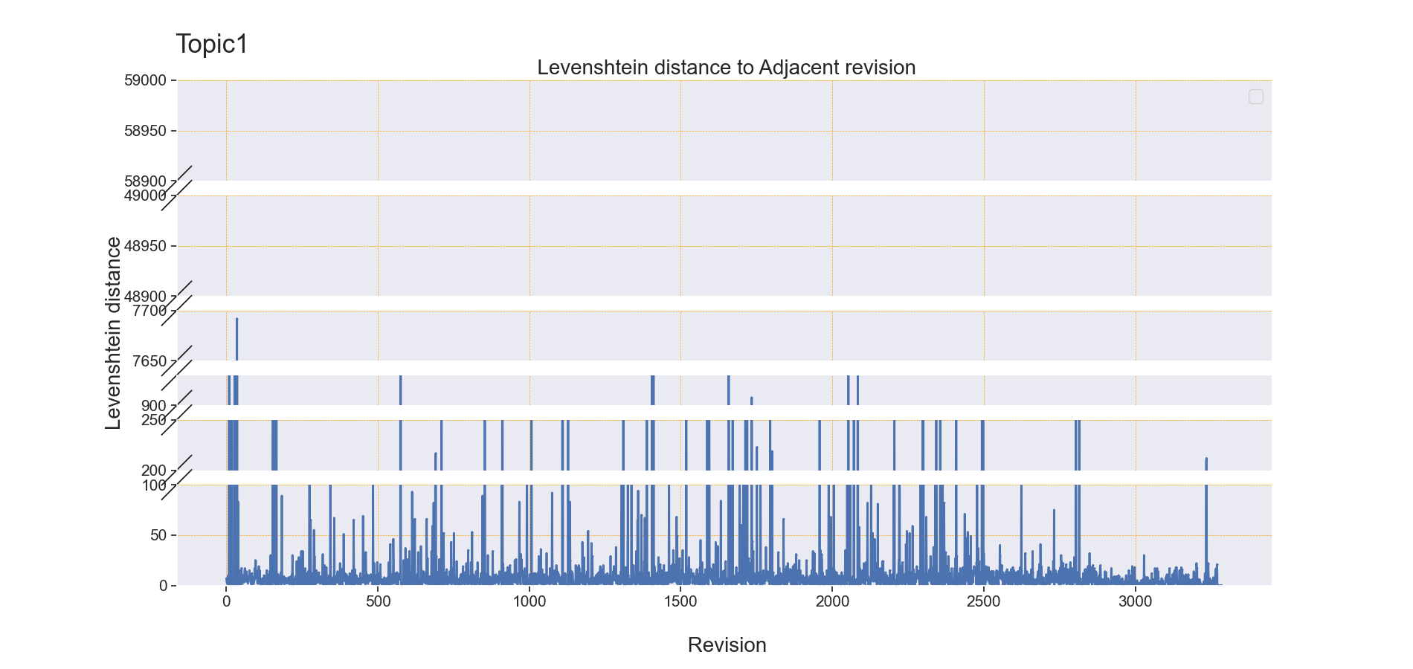
DATA PREPROCESSING
DATA ANALYSIS
The Levenshtein distance.
Bauhaus University, Weimar

Slide 27
TEXT QUALITY MEASURES
COHERENCE
TYPE-TOKEN
RATIO
READABILITY
Bauhaus University, Weimar

Slide 28






TEXT QUALITY MEASURES
COHERENCE USING ENTITY GRID MODEL
(Modeling Local Coherence: An Entity-based Approach; Regina Barzilay, Mirella Lapata)
Create Transition Table (Pairing with adjacent cell in each Column)
Generate POS Tagger using CoreNLP
With the help of Generated POS Tagger, create Entity grid Table
Finally calculate coherence score by using cosine similarity from transition vector
Calculate transition vector using transition table
Bauhaus University, Weimar

Slide 29
TEXT QUALITY MEASURES
READABILITY
Flesch reading Ease Formula.
206.835 − (1.015 × ASL) − (84.6 × ASW)
Textstat python library.
Bauhaus University, Weimar

Slide 30
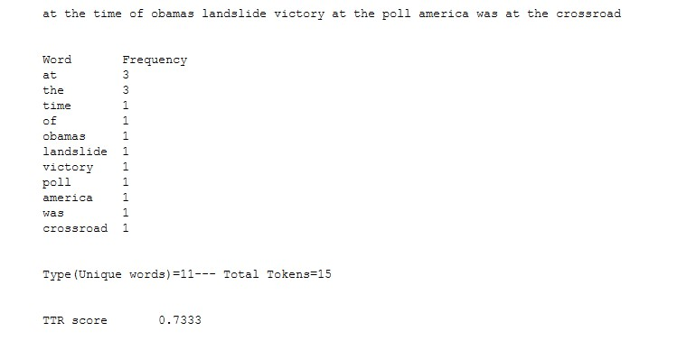
TEXT QUALITY MEASURES
TYPE-TOKEN RATIO
Bauhaus University, Weimar

Slide 31
RESEARCH QUESTION RQ1 SETUP
RQ1
What are the different types of editing techniques in search-supported writing ?
RQ2
How do different types of editing affect Coherence, Type-Token ratio, and Readability?
RQ3
How do different essay writing strategies affect Coherence, Type-Token ratio, and Readability?
Bauhaus University, Weimar

Slide 32


EDITING TYPES
EDITING TYPES
EXAMPLES OF EDITING TYPES
AUTOMATIC IDENTIFICATION OF EDITING TYPES
Bauhaus University, Weimar

Slide 33
EDITING TYPES
EDITING TYPES
1st Revision
2nd Revision
01
How is the second revision edited compared to the first revision.
02
Analyse across pairs of adjacent revisions.
03
Identified five different editing types.
Bauhaus University, Weimar
Notes:
Editing types mean how the second revision is edited compared to first revision.
During analysing dataset we identify different editing types.
We analyse across pairs of adjacent revisions.

Slide 34
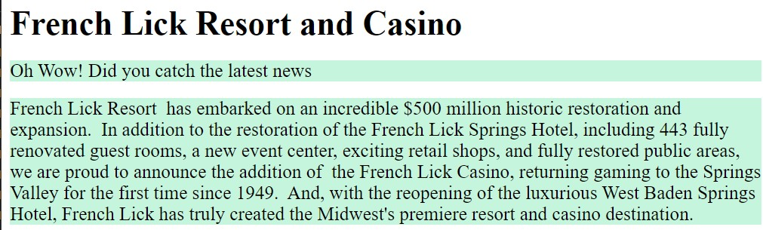

EDITING TYPES
EXAMPLE OF EDITING TYPES
Block Edit
1
1
2
2
3
3
4
4
Before
After
Bauhaus University, Weimar

Slide 35


EDITING TYPES
EXAMPLE OF EDITING TYPES
Block Merged
1
1
2
2
3
3
4
Before
After
Bauhaus University, Weimar

Slide 36


EDITING TYPES
EXAMPLE OF EDITING TYPES
Block Split
1
1
2
2
3
3
4
Before
After
Bauhaus University, Weimar

Slide 37

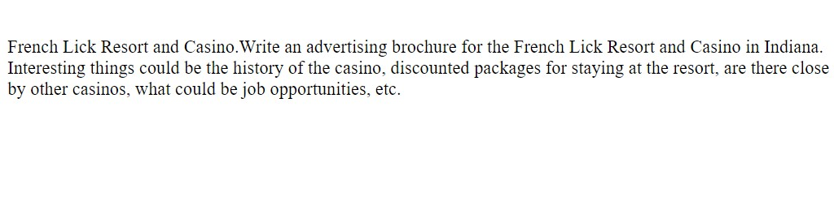
EDITING TYPES
EXAMPLE OF EDITING TYPES
Block Insertion
1
1
2
2
3
3
4
Before
After
Bauhaus University, Weimar

Slide 38
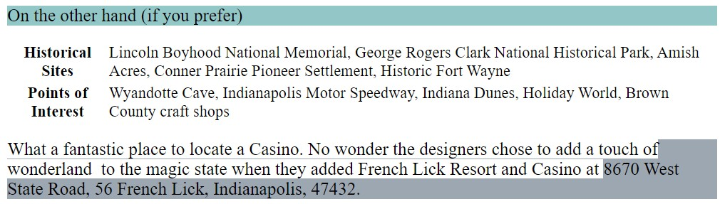
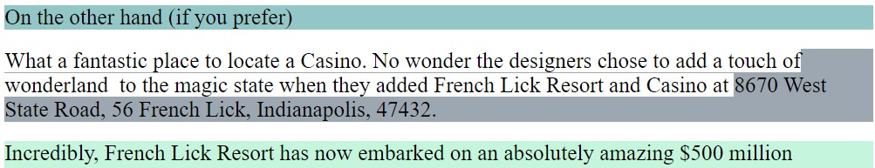
EDITING TYPES
EXAMPLE OF EDITING TYPES
Block Deletion
1
1
2
2
3
3
4
Before
After
Bauhaus University, Weimar

Slide 39







EDITING TYPES
LEGENDS
AUTOMATIC IDENTIFICATION OF EDITING TYPES
=
No Changes
Changes
Decrease
Increase
01
Number of characters and paragraphs play a vital role.
Block edited
number of paragraphs =
number of characters
Block deletion
number of paragraphs
number of characters
1
Block merged
5
2
number of paragraphs
number of characters =
EDITING TYPES
Block insertion
4
3
number of paragraphs
number of characters
Block split
number of paragraphs
number of characters =
Bauhaus University, Weimar
Notes:
Check the number of character and number of paragraph in adjacent revision.

Slide 40
RESULT AND ANALYSIS
EDITING TYPES ?
EFFECTS OF EDITING
TYPES?
EFFECTS OF WRITING
STYLES?
Bauhaus University, Weimar

Slide 41
RESULT AND ANALYSIS
RESEARCH QUESTION RQ1
RQ1
What are the different types of editing techniques in search-supported writing ?
RQ2
How do different types of editing affect Coherence, Type-Token ratio, and Readability?
RQ3
How do different essay writing strategies affect Coherence, Type-Token ratio, and Readability?
Bauhaus University, Weimar

Slide 42
RESULT AND ANALYSIS
RQ1: DIFFERENT EDITING TYPES
Editing Types | Description
Block edited | Blocks are manually edited
Block merged | Two different blocks are merged
Block split | One block split into two
Block insertion | New block is inserted
Block deletion | Block is deleted
Bauhaus University, Weimar

Slide 43
RESULT AND ANALYSIS
RESEARCH QUESTION RQ2
RQ1
What are the different types of editing techniques in search-supported writing ?
RQ2
How do different types of editing affect Coherence, Type-Token ratio, and Readability?
RQ3
How do different essay writing strategies affect Coherence, Type-Token ratio, and Readability?
Bauhaus University, Weimar

Slide 44
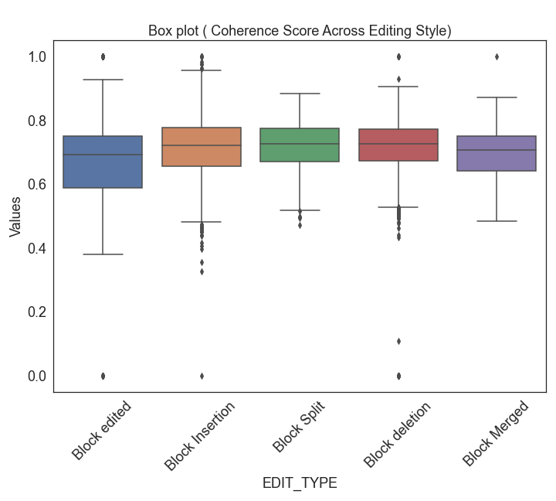
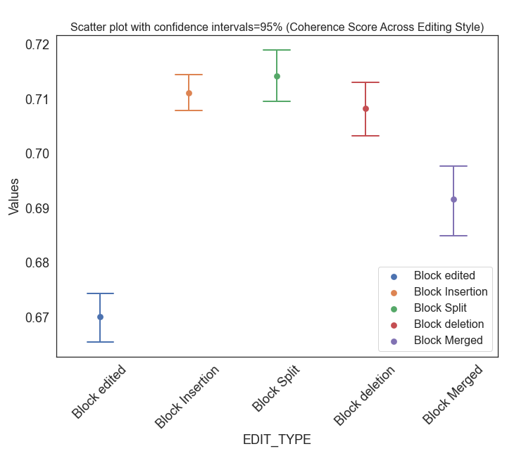
RESULT AND ANALYSIS
RQ2: EFFECTS OF EDITING TYPES ON TEXT QUALITY
Bauhaus University, Weimar

Slide 45
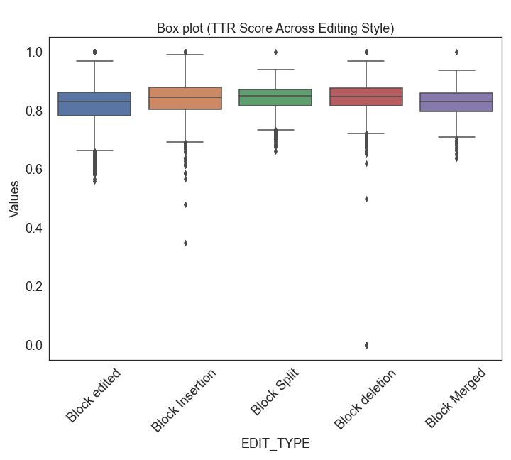
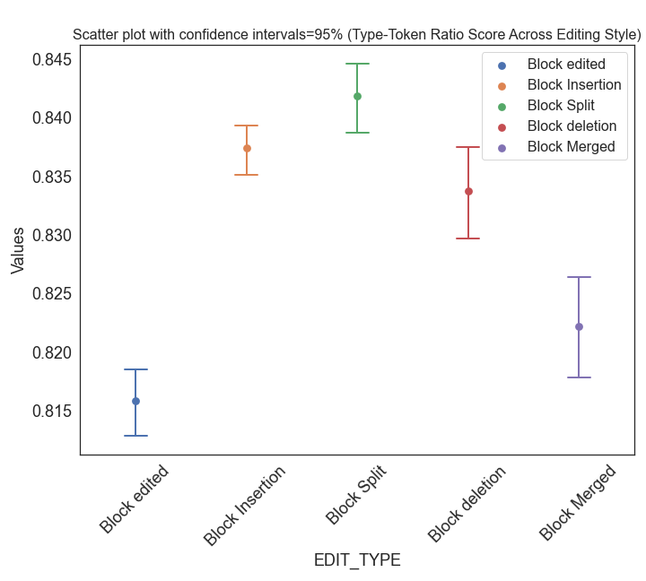
RESULT AND ANALYSIS
RQ2: EFFECTS OF EDITING TYPES ON TEXT QUALITY
Bauhaus University, Weimar

Slide 46
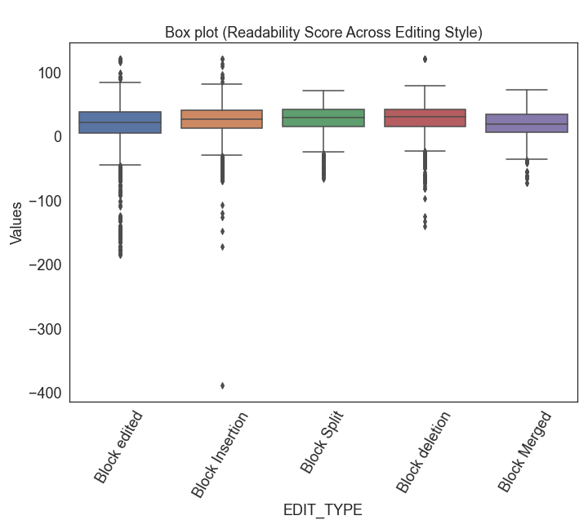
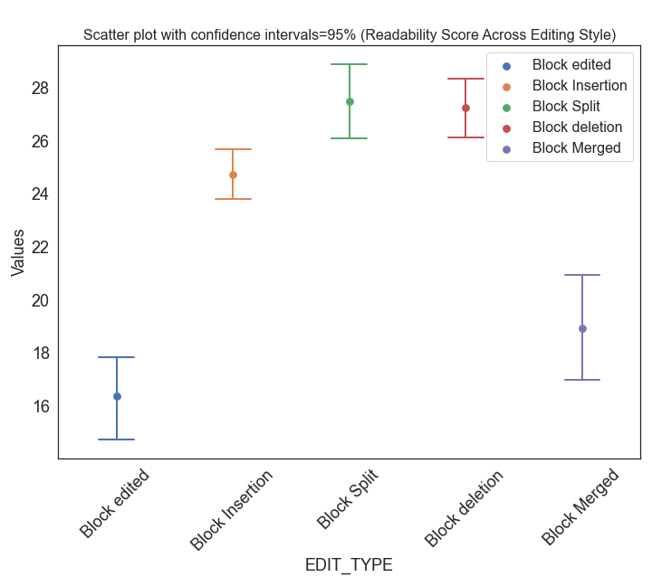
RESULT AND ANALYSIS
RQ2: EFFECTS OF EDITING TYPES ON TEXT QUALITY
Bauhaus University, Weimar

Slide 47
RESULT AND ANALYSIS
RESEARCH QUESTION RQ3
RQ1
What are the different types of editing techniques in search-supported writing ?
RQ2
How do different types of editing affect Coherence, Type-Token ratio, and Readability?
RQ3
How do different essay writing strategies affect Coherence, Type-Token ratio, and Readability?
Bauhaus University, Weimar

Slide 48
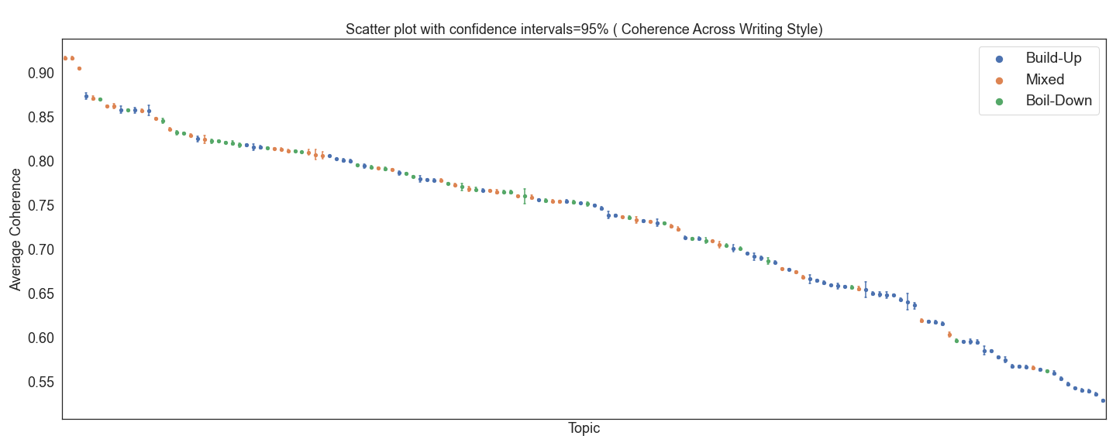
RESULT AND ANALYSIS
RQ3: EFFECTS OF WRITING STYLES ON TEXT QUALITY
Bauhaus University, Weimar

Slide 49
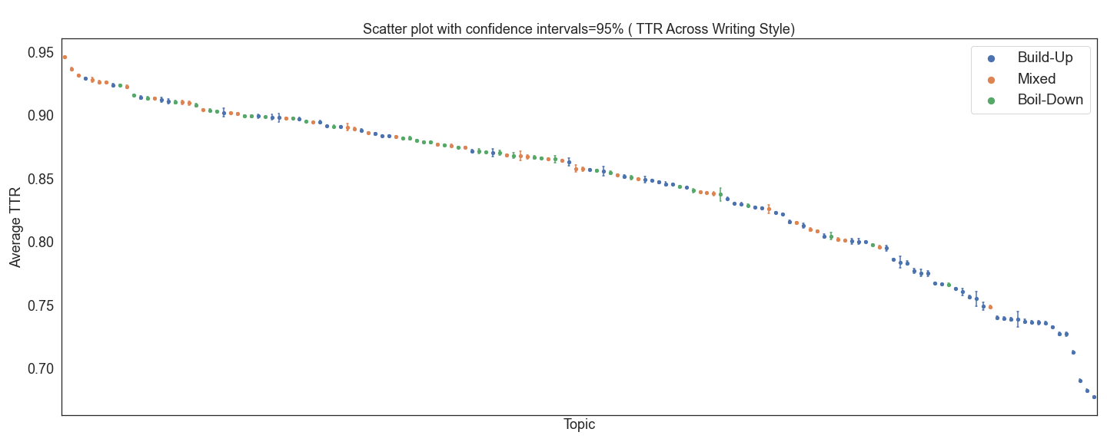
RESULT AND ANALYSIS
RQ3: EFFECTS OF WRITING STYLES ON TEXT QUALITY
Bauhaus University, Weimar

Slide 50
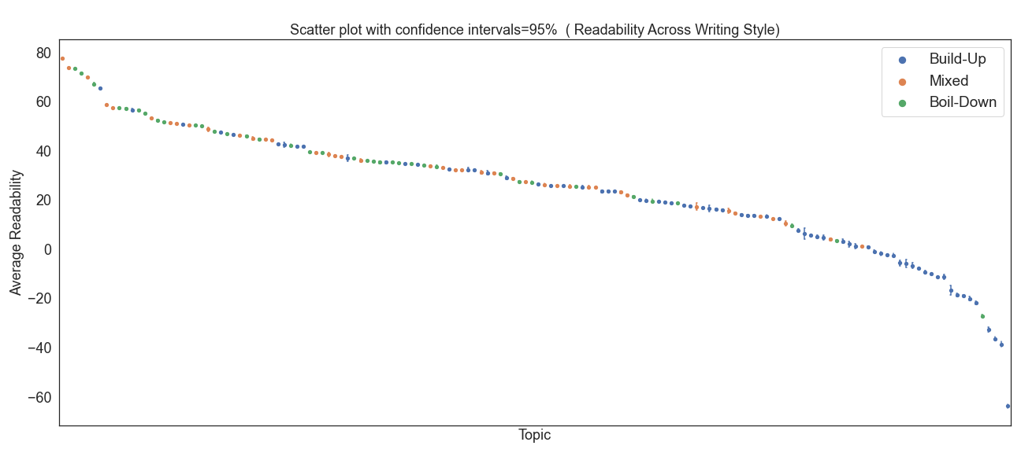
RESULT AND ANALYSIS
RQ3: EFFECTS OF WRITING STYLES ON TEXT QUALITY
Bauhaus University, Weimar

Slide 51
CONCLUSION
MAIN FINDINGS
FUTURE WORK
Bauhaus University, Weimar

Slide 52
CONCLUSION
MAIN FINDINGS
RQ1
Different editing types: Block Edited, Block Merged, Block Split, Block Insertion, and Block Deletion.
Editing types affect readability, but Coherence and Type token ratio have same pattern in every editing types.
RQ2
RQ3
Most of the essays with build-up writing are having lower coherence, TTR, and readability scores
Coherence, TTR, and readability are higher in mixed writing
Bauhaus University, Weimar

Slide 53
CONCLUSION
FUTURE WORK
01
Investigate the lower coherence, TTR, and Readability in Build-up writing.
Investigate effects of introducing new entities in text.
02
03
How coherence is affected by cohesion.
Bauhaus University, Weimar
Notes:
Investigate affect of introducing new entities in particular affect the coherence score.

Slide 54

Thank you for your attention!
Bauhaus University, Weimar

Slide 55
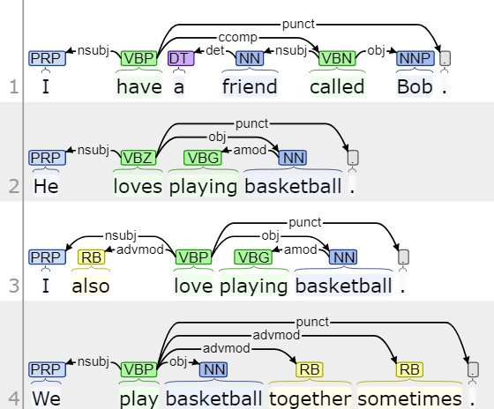
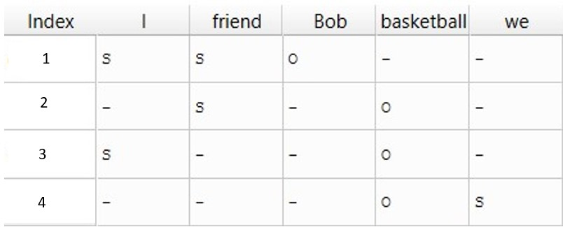
Appendix
COHERENCE (Modeling Local Coherence: An Entity-based Approach; Regina Barzilay, Mirella Lapata)
For example we take "I have a friend called Bob. He loves playing basketball. I also love playing basketball. We play basketball together sometimes.”
LEGEND
PRP - Personal Pronoun
NN - Noun, Singular
NNP - Proper Noun, Singular
Bauhaus University, Weimar

Slide 56
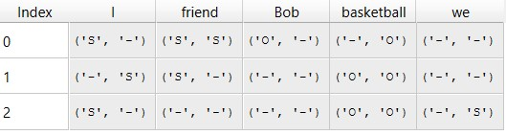
Appendix
COHERENCE (Modeling Local Coherence: An Entity-based Approach; Regina Barzilay, Mirella Lapata)
SS | SO | S - | OS | OO | O - | - S | - O | - -
0.066 | 0 | 0.2 | 0 | 0.133 | 0.066 | 0.133 | 0.066 | 0.33
Bauhaus University, Weimar

Slide 57
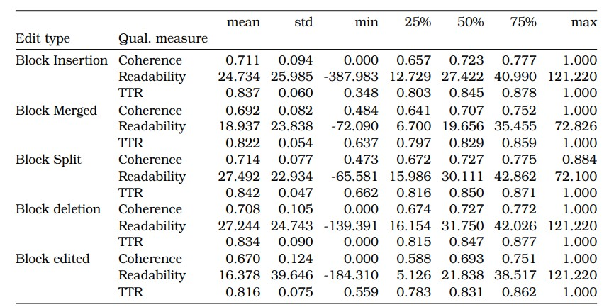
Appendix
2
3
2
4
4
4
1
1
1
3
2
3
5
2
5
Bauhaus University, Weimar

Slide 58
Bauhaus University, Weimar

